Slide 1
ACHIEVEMENTS 2019/2020
Capital Developments
Construction of Staff houses
Construction of Classroom blocks
Construction of VIP latrines
Construction of Seed Secondary School
Completion and Rehabilitation of Schools (Emergency Fund)

Slide 2
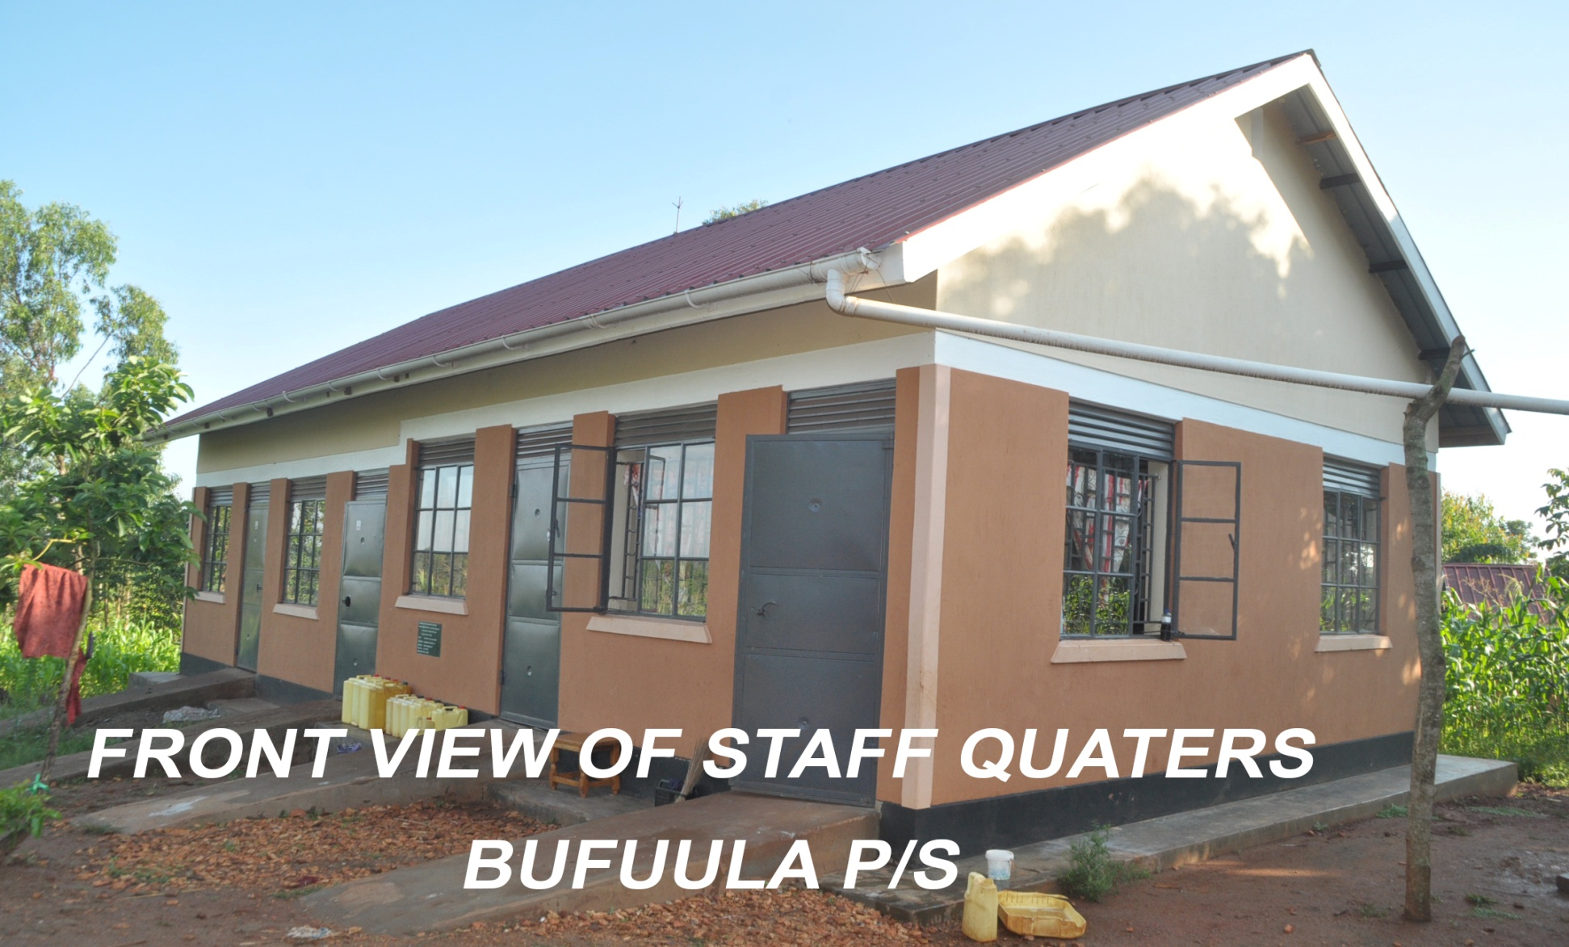
A 4 unit staff house at Bufuula Primary School – Budondo S/C

Slide 3
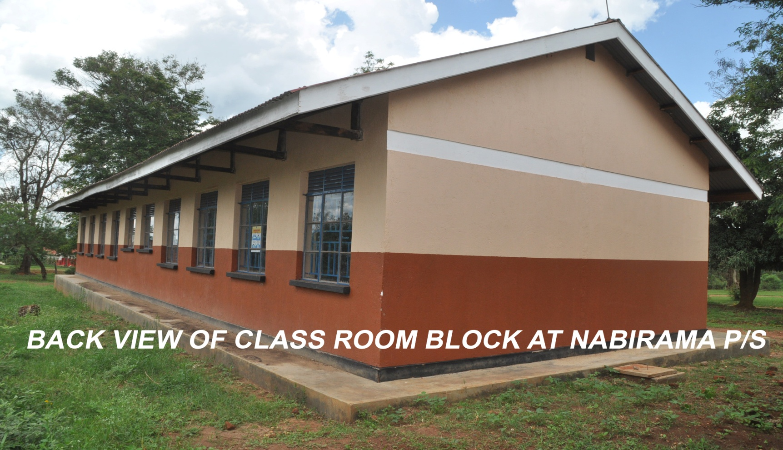
Classroom block at Nabirama P/S – Busede S/C

Slide 4
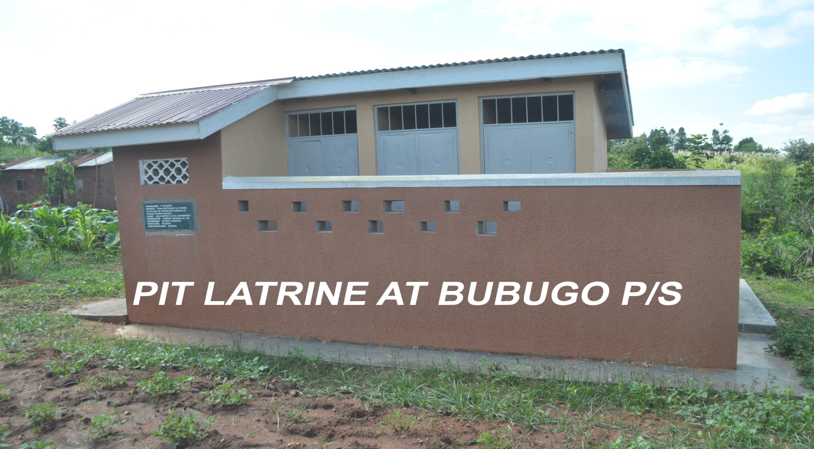
4 stance Pit Latrines for staff house at Bubugo P/S – Butagaya S/C.

Slide 5
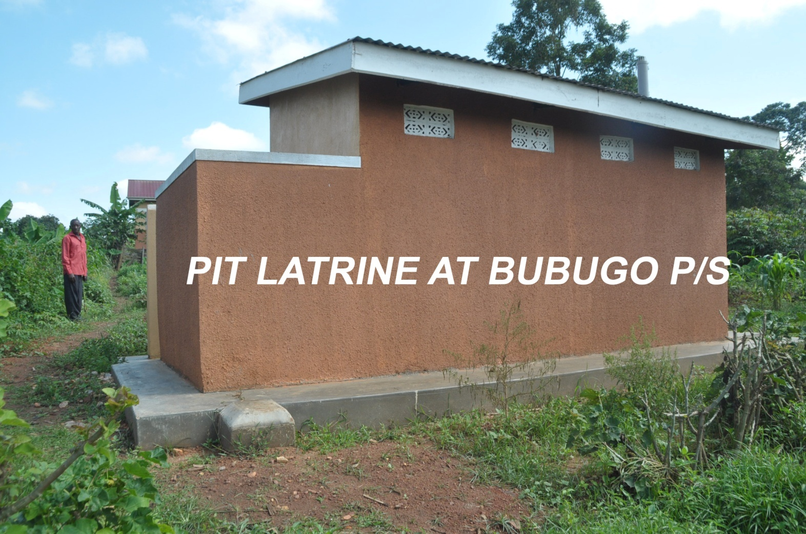

Slide 6
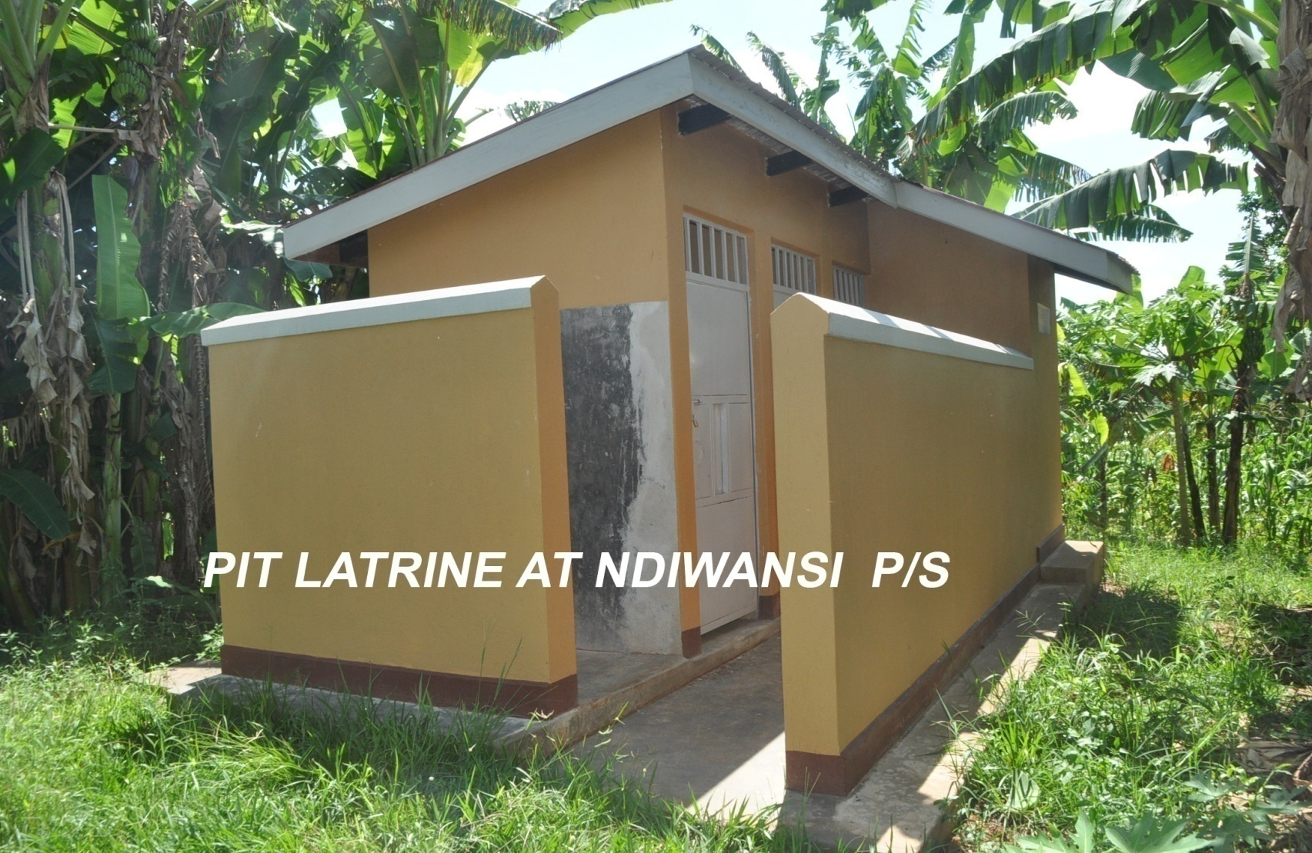
4 stance Pit Latrine at Ndiwansi P/S – Butagaya S/C

Slide 7
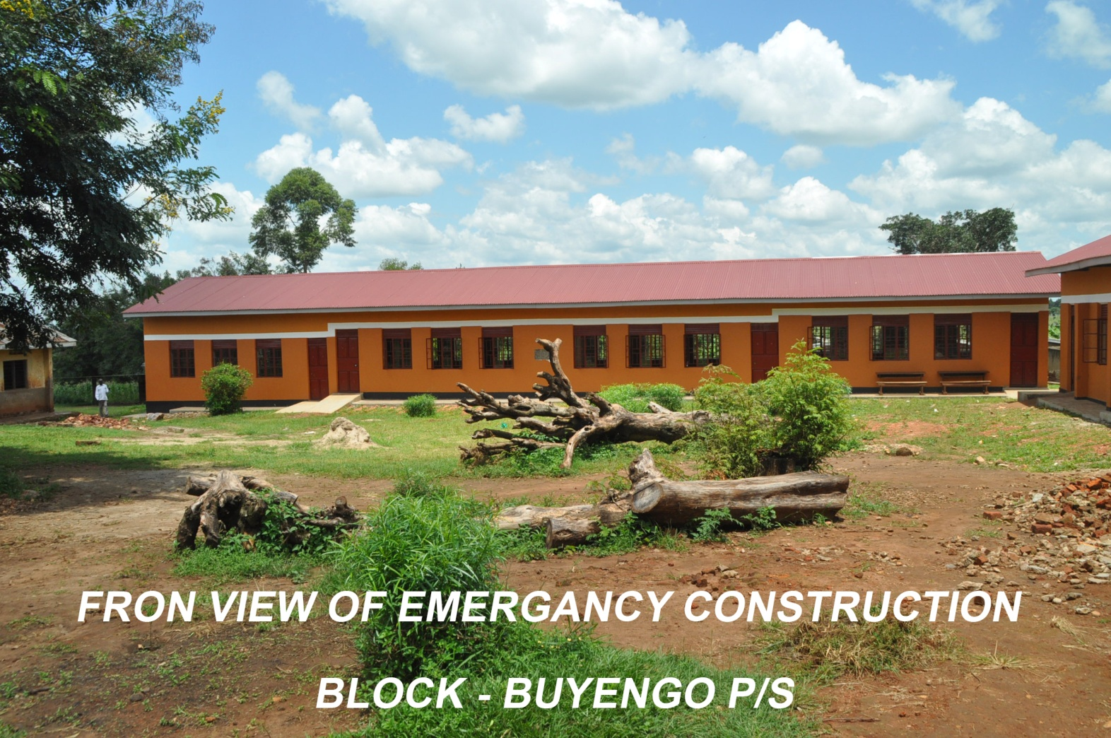

Slide 8
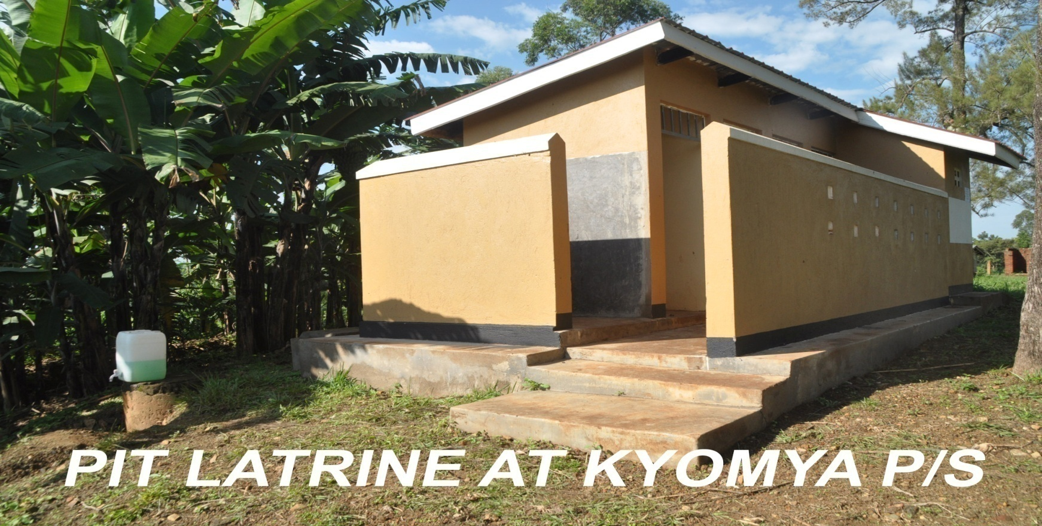
Construction of a 5 stance VIP brick lined pit latrine at Kyomya P/S – Budondo S/C

Slide 9
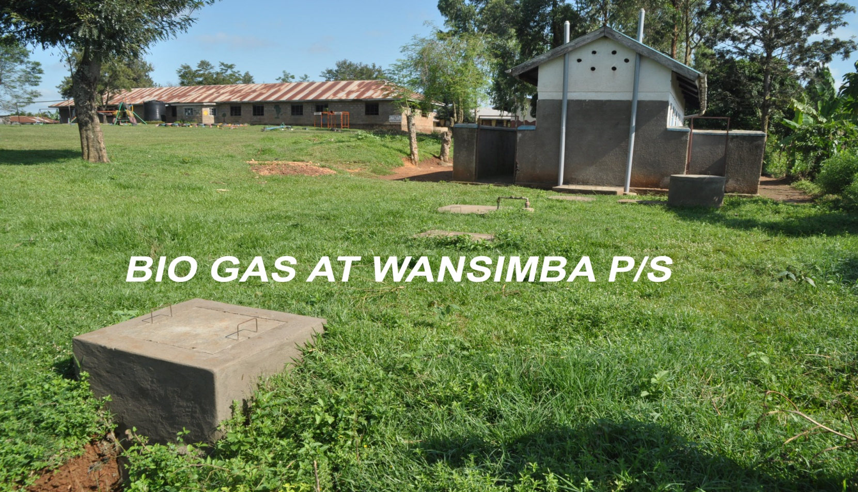
Phase 1 Enhancing of the biogas system at Wansimba P/S – Butagaya S/C

Slide 10
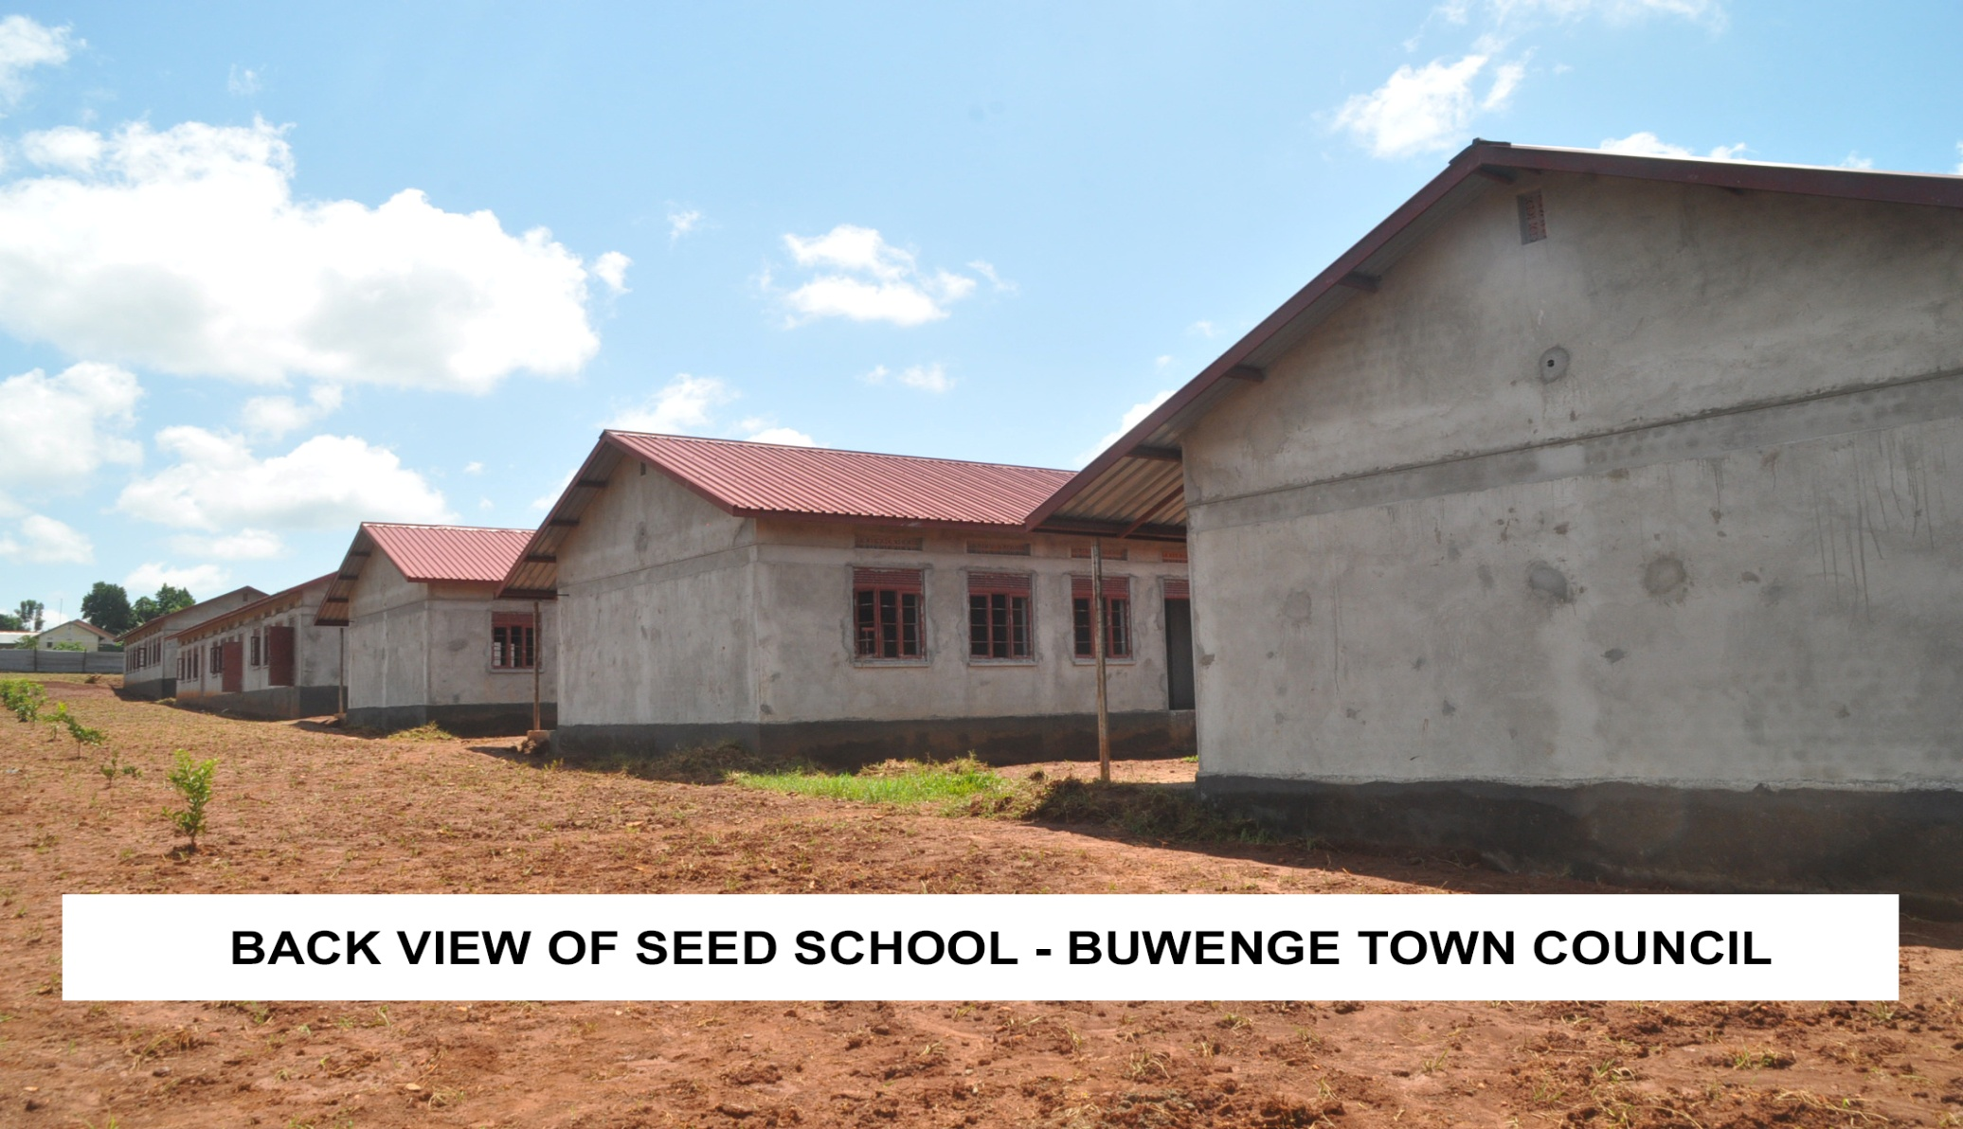
Construction of Buwenge Seed Secondary School – Buwenge T/C

Slide 11
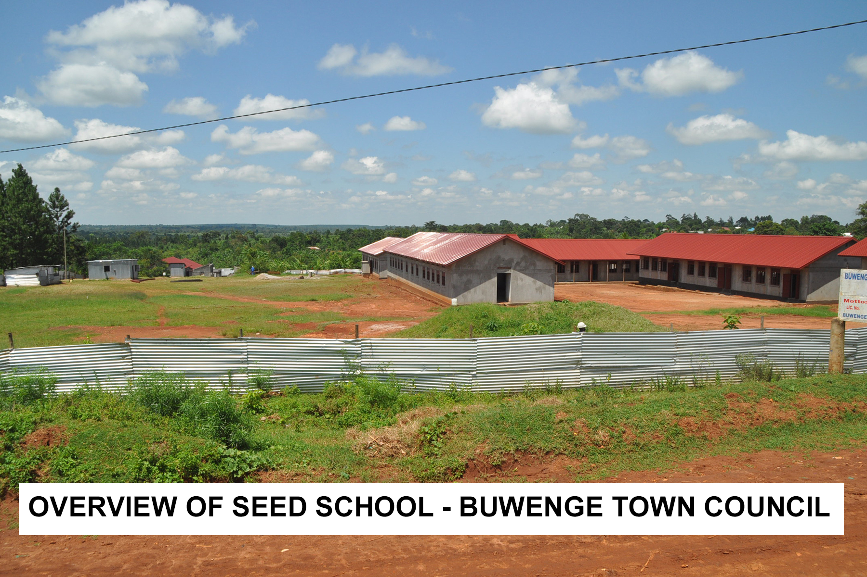

Slide 12
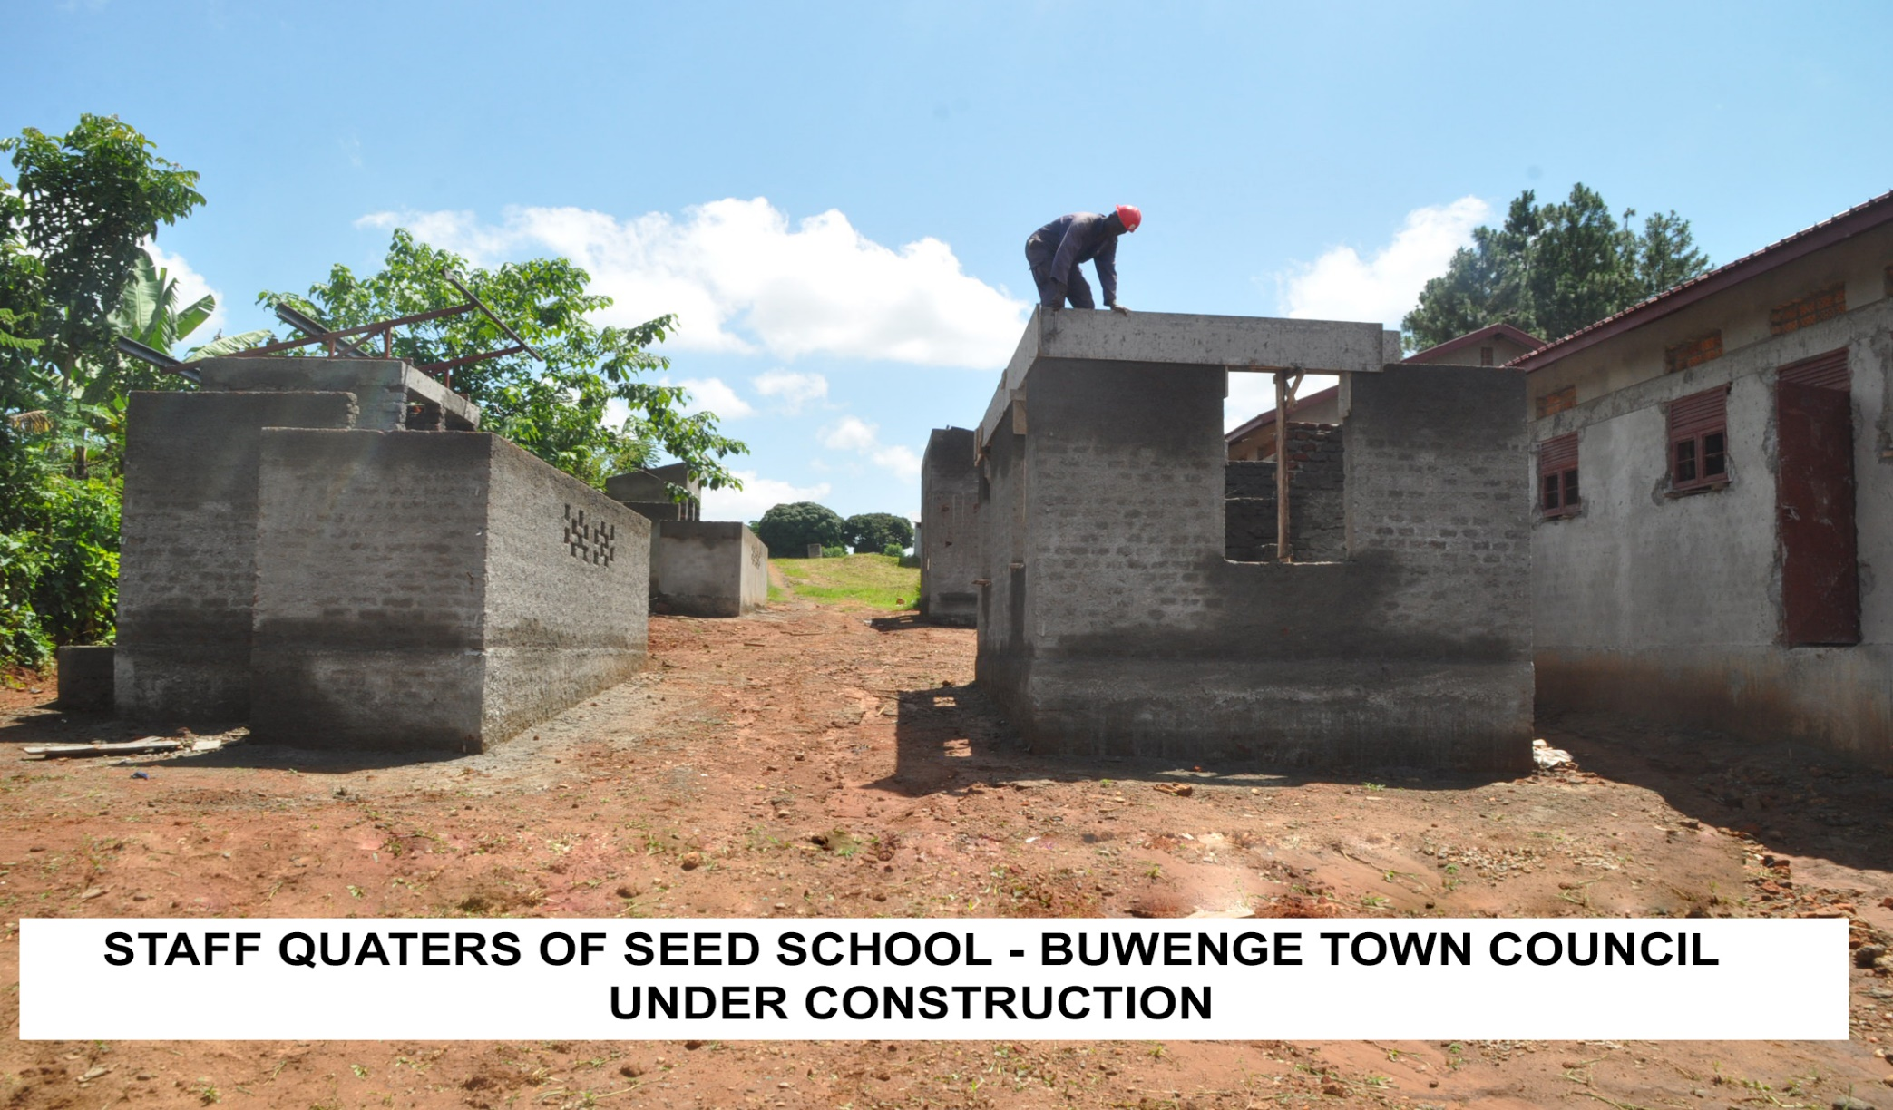
Buwenge Seed Sch cont’d.

Slide 13
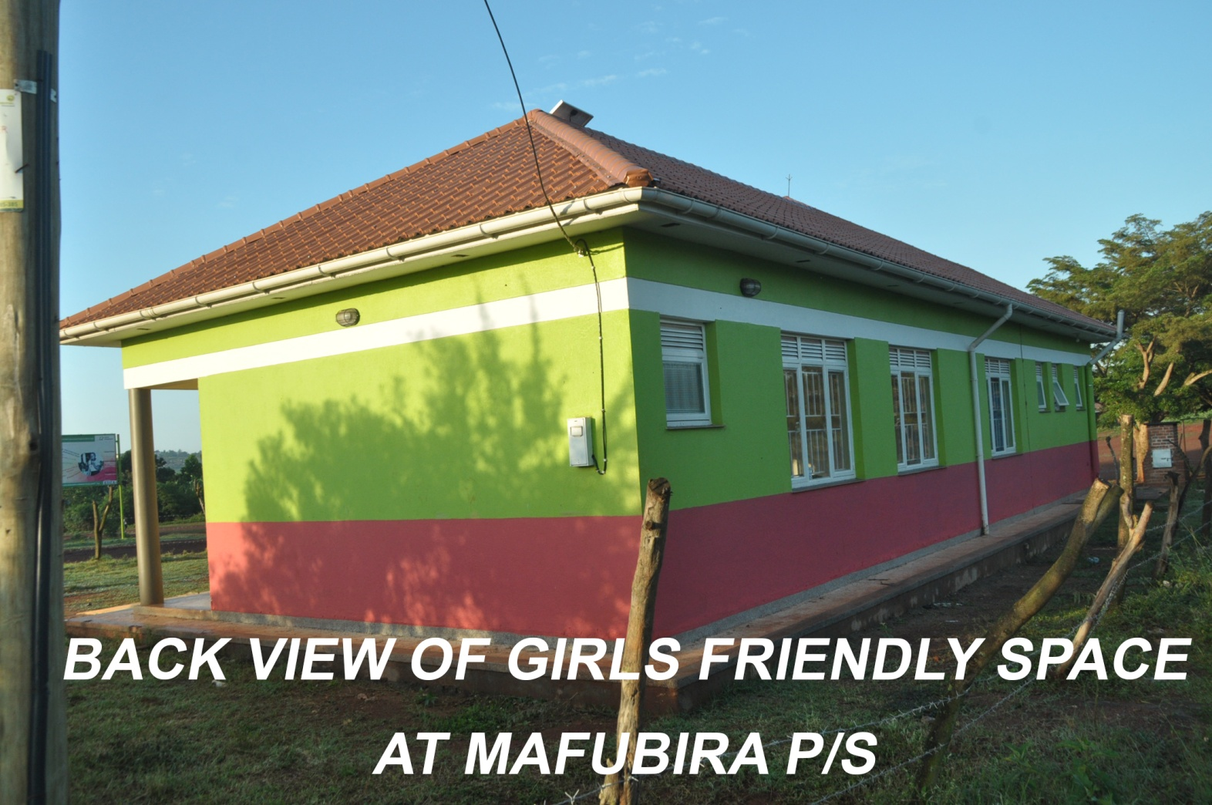
GOOD NEIGHBOURS: Construction of Girl Friendly Spaces at MM Wanyange, Mafubira and Buyala Primary Schools

Slide 14
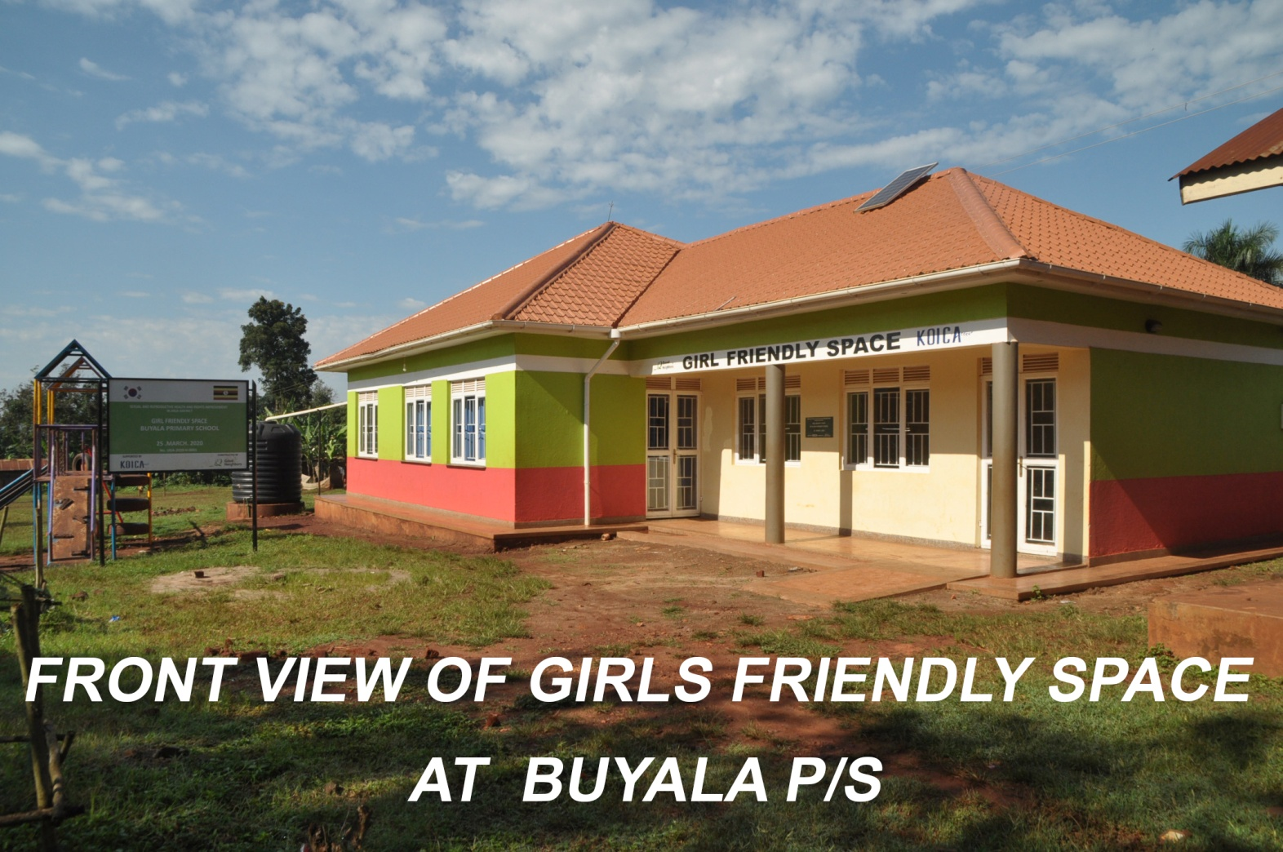

Slide 15
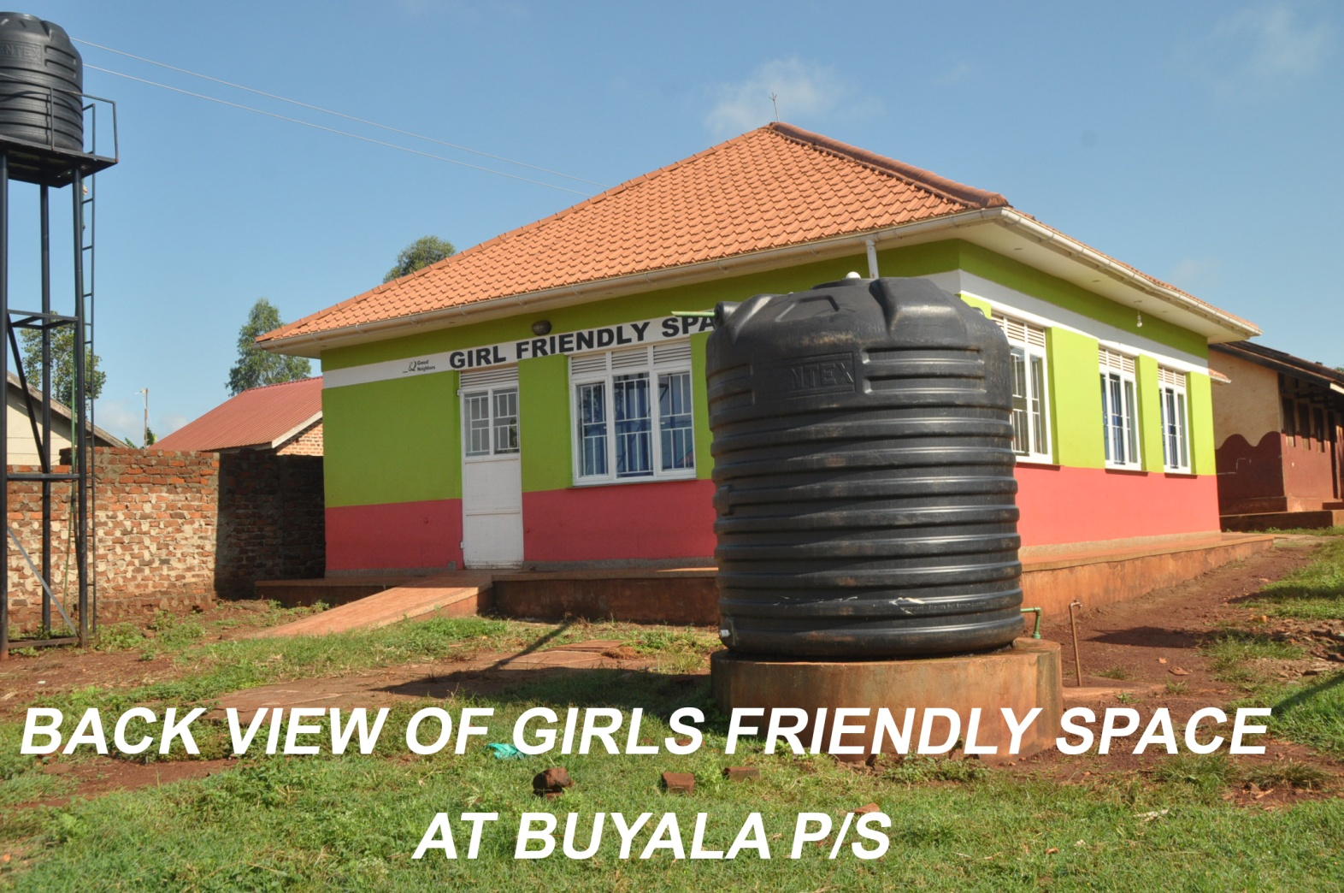
Girl friendly spaces cont’d

Slide 16
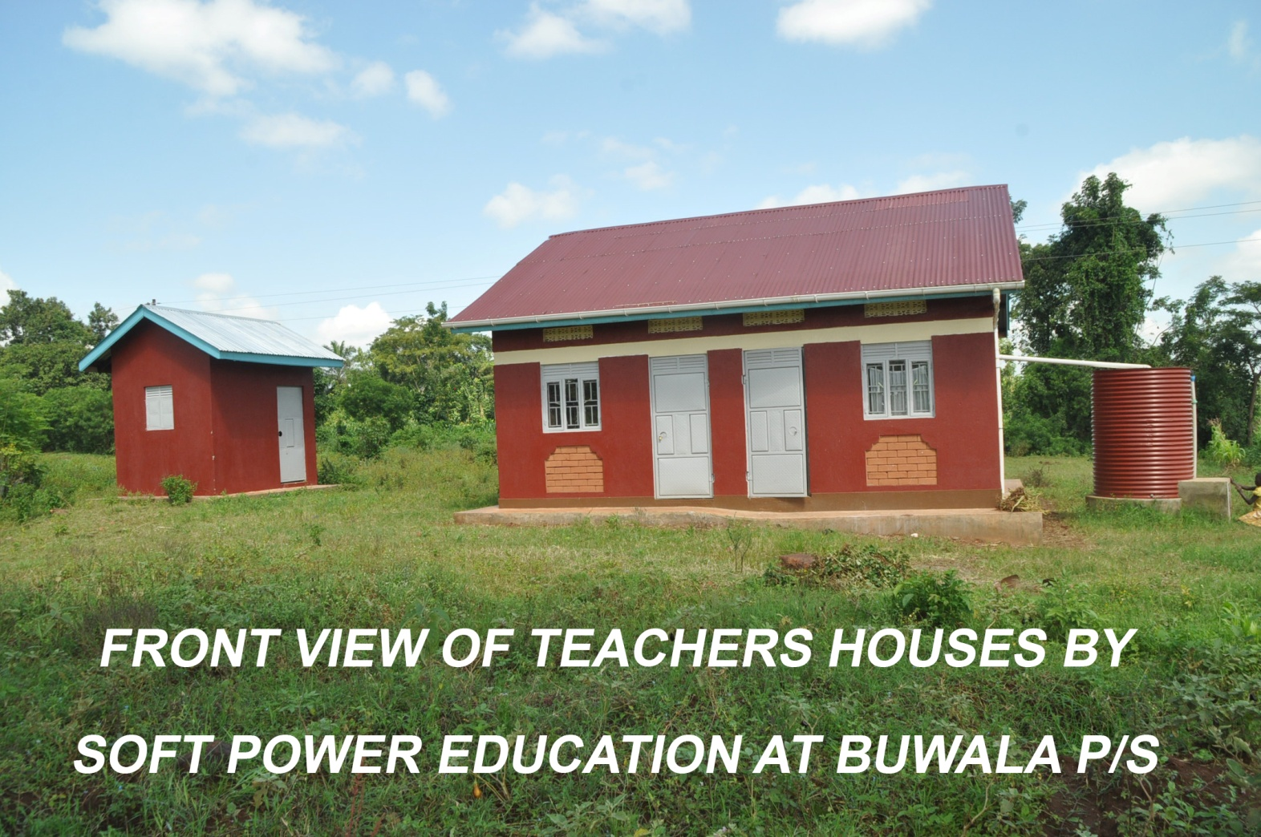
SOFT POWER EDUCATION: Construction of 2 in 1 staff houses for Bituli and Buwala P/S

Slide 17
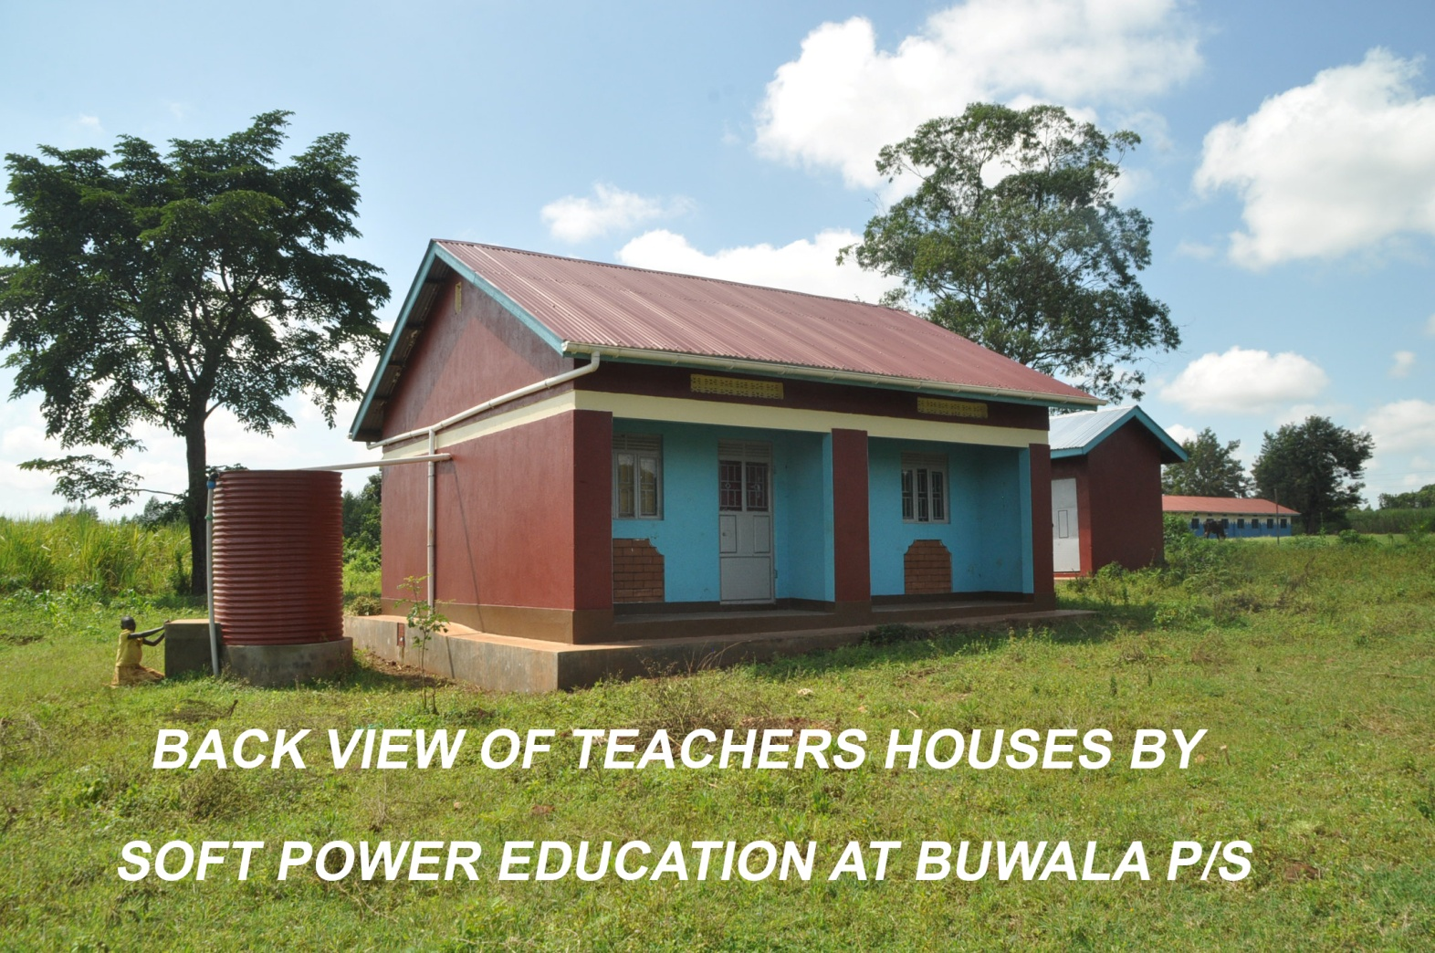
Soft Power Educ. Cont’d

Slide 18
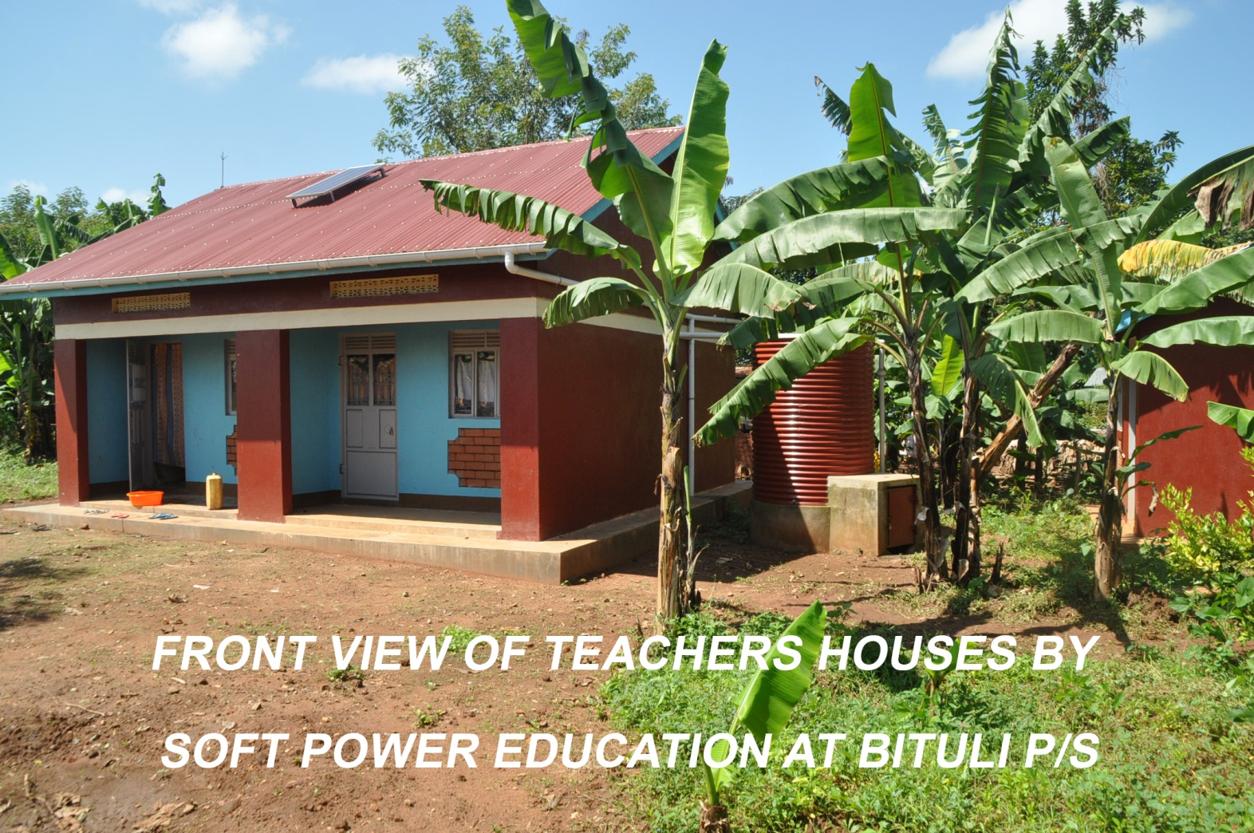
Soft Power Educ cont’d.

Slide 19
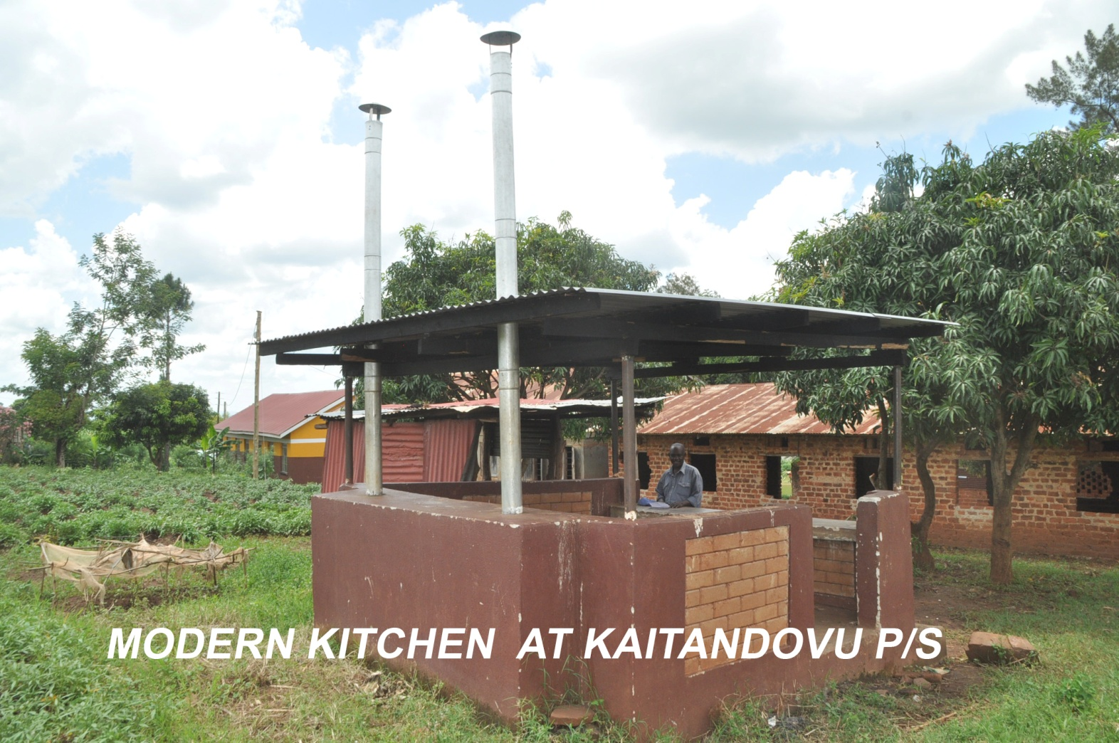
ROTARY INTERNATIONAL: Construction of simple modern kitchen at Kakuba, Kaitandhovu, Kagogwa and Nyenga Primary Schools

Slide 20
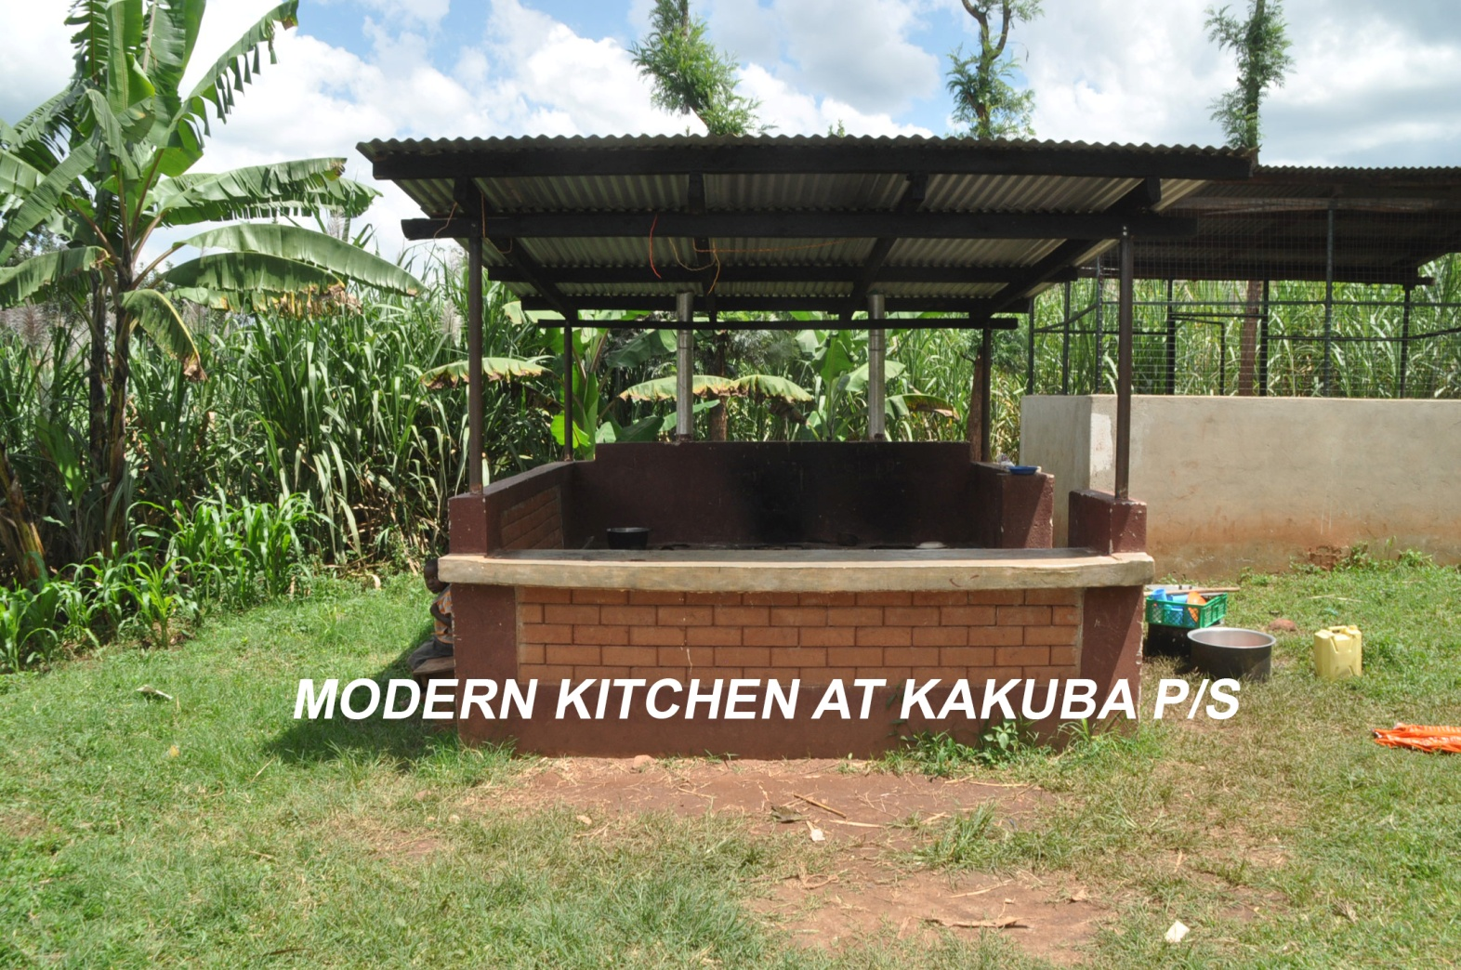
Rotary International cont’d.

Slide 21
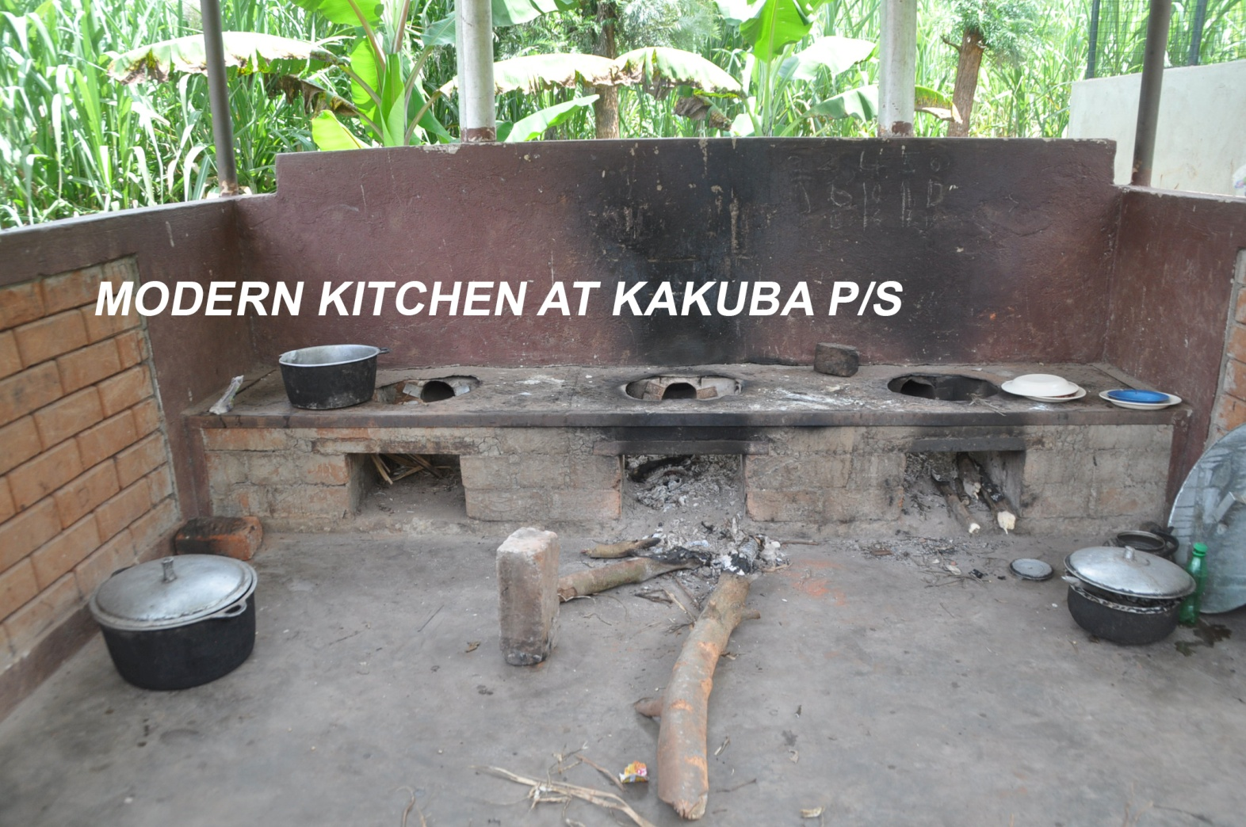
Rotary International cont’d.

Slide 22
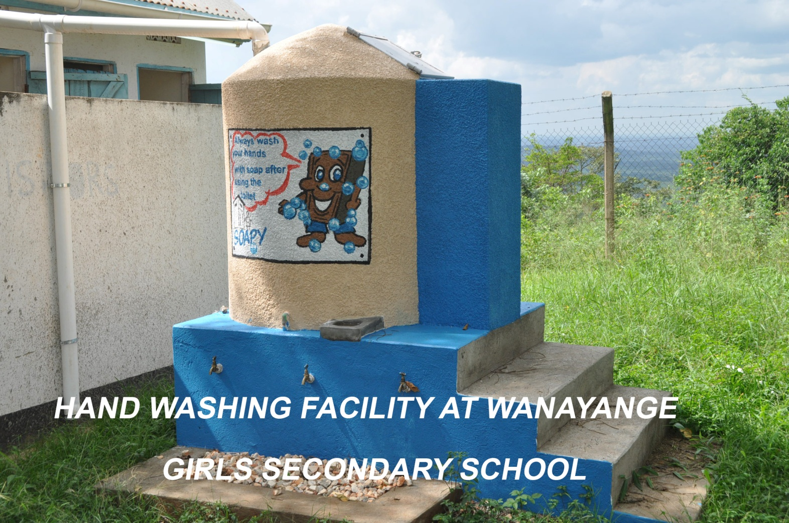
UGANDA SANITATION FOR HEALTH ACTIVITIES(USHA)

Slide 23
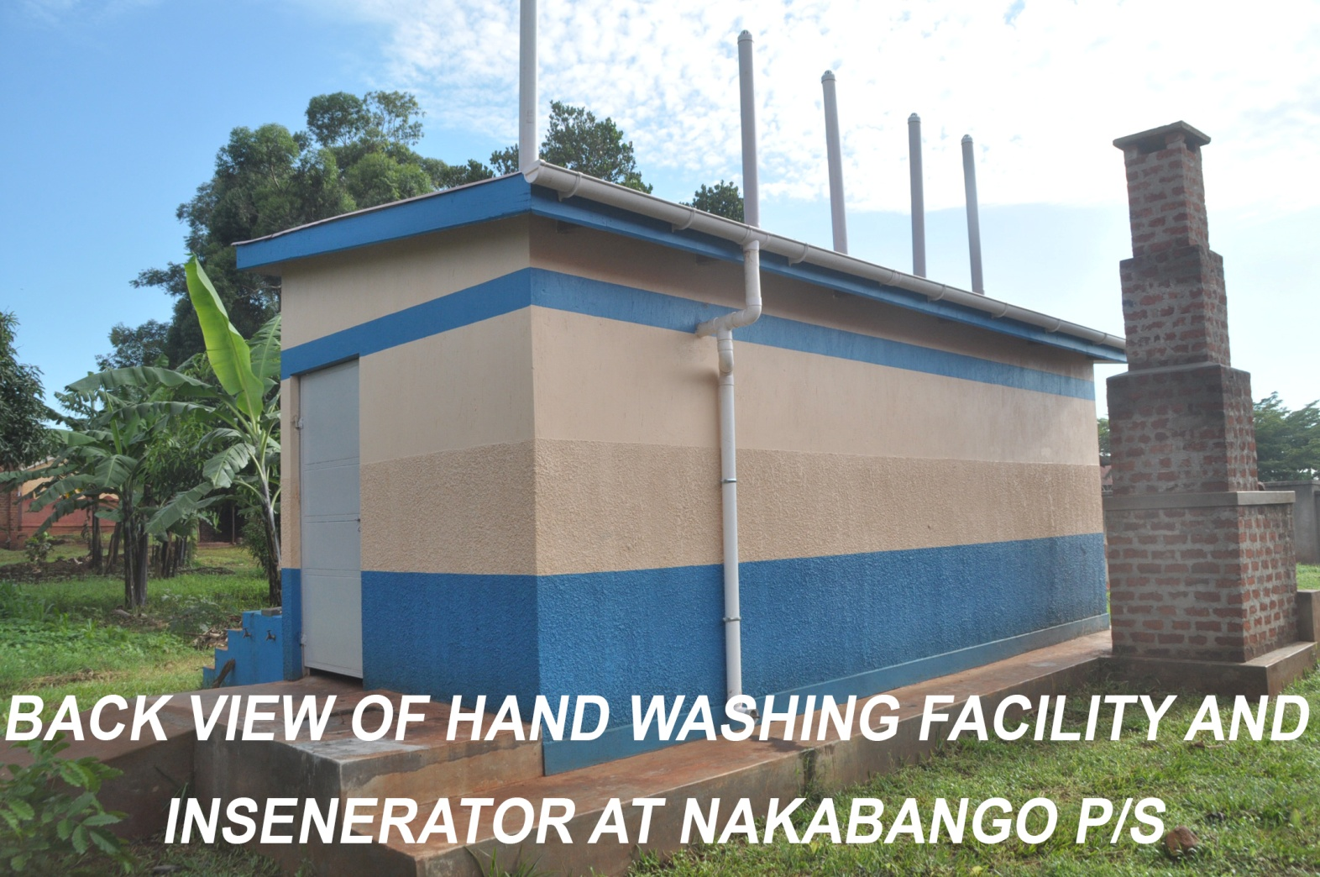
USHA cont’d.

Slide 24
Others
All our schools have re opened after the lock down and have the required SOPs
Most schools have got school gardens and other projects
Many schools have planted trees especially along the boundaries

Slide 25
PRIORITIES 2021/22
Construction of 4 unit staff houses at Iziru P/S, Lubani P/S and Mawoito Salvation P/S
Construction of 5 stance VIP latrines with hand washing facilities at Isiri P/S, Buwenge Township P/S, Imam Hassan P/S, Lumuli P/S and St. Stephen P/S, and Wairaka P/S.
Enhancing bio gas system at Namaganga Primary School.

Slide 26
Priorities cont’d.
Renovation and Rehabilitation of classrooms at Nkondo, Nyenga and Kagoma Primary Schools.
Seed School construction at Buwala Seed Secondary School, Butagaya Sub County.
Emergency construction at St. Kaloli Bulama(A 4 classroom block)

Slide 27
UNFUNDED PRIORITIES
Unfunded priorities Estimates
Construction of 430 classrooms to achieve the national classroom: pupil ratio of 1:53 | 15,372,500,000
Construction of storied classroom structures for urban schools which lack space land like Busiya I parents, Buwenge Township and Buwenge SDA in Buwenge Town council, Nakanyonyi and Bugembe in Bugembe Town Council | 1,152,000,000
Construction of Water borne toilets for Schools in urban centres | 204,000,000
Construction of 261,teachers houses to cub late coming and absenteeism of teachers | 19,575,000,000
Construction of 2 five stance VIP brick lined pit latrines for the 87 Public Primary Schools. | 3,480,000,000
Purchase of two double cabin pick-ups for inspectorate activities | 320,000,000

Slide 28
Purchase of SNE materials including Audio/Visual, Play materials and gadgets to equip the Special Needs Education units. | 132,000,000
Purchase of Games and Sports, Music Dance and Drama equipment for Schools and facilitating the District, Regional and National levels. | 96,000,000
Construction of Multipurpose science blocks of 10 secondary schools | 2,480,049,960
Construction of Head teaches and Deputy Head teacher house for 8 secondary schools. | 1,561,279,104
Reroofing of Wanyange Girls, MM College Wairaka, Busoga College Mwiri, PMM Girls, Jinja College, Jinja S.S.S and Mwiri Primary School with Iron Sheets to replace asbestos. | 1,000,000,000
Completion of SNE resource rooms at Mafubira and Bubugo Primary School | 130,000,000
Construction of 6 model ECD centres for other Schools to bench mark | 780,000,000
Construction of a Multibillion Science and technology Tertiary Institution (University) | 70,000,000,000

Slide 29
Challenges
Inadequate class rooms to achieve the National ratio
Inadequate staff houses
Lack of Fences around schools
Inadequate transport means to education staff
Co- curricular activities are under funded
Urban schools Lack land for expansion
Many schools have incomplete structures
Some schools still have asbestos roofs
Department lacks equipments for games and sports
Some schools lack laboratories and modern science equipment.

Slide 30
Strategies for Better Performance
Re engagement of all stakeholders to work towards better quality work.
Posting of headteachers to base on performance verses capitation. High performers to be posted to schools with higher capitation.

