Slide 1
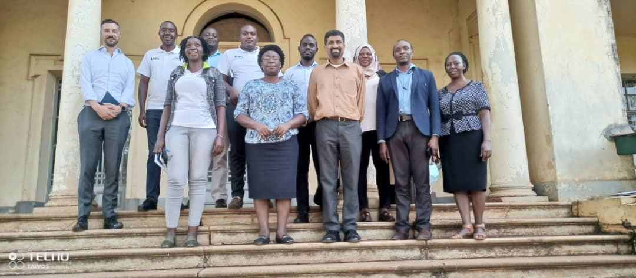
World Bank Delegation, NITA U and MoICT staff together with CAO –Jinja Ms Nakamatte Lilian in the middle

Slide 2
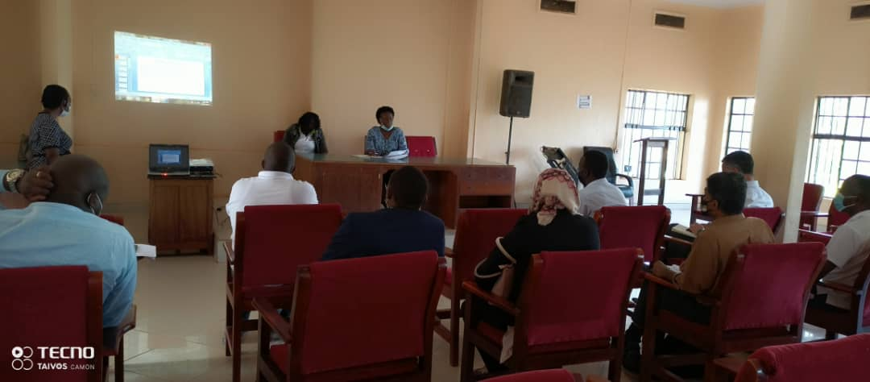
CAO Jinja Testifying the Good Works and services done by NITA U in Jinja District Local Government

